Slide 1
Resolution vs. Storage: Navigating the Computer Vision Trade-off
A focused guide to understanding how spatial resolution and storage interact in computer vision systems. We'll compare technical trade-offs, show practical analysis with visuals, and outline tactical strategies for building systems that balance fidelity, cost, and performance. Use this deck to decide what to capture, what to compress, and how to architect storage and processing for real-world CV applications.

Slide 2




What is Spatial Resolution?
Spatial resolution describes a system's ability to resolve fine detail — effectively how small a feature can be distinguished. In imaging, it's typically tied to pixel size, optics, and sensor sampling; higher pixel count alone does not guarantee higher effective resolution. Key points:
Pixels vs. Resolution
Pixel count (MP) is one metric, but optical quality, sampling, and demosaicing determine true resolving power.
Optics Matter
Lens MTF (modulation transfer function) and focus depth often limit effective resolution before pixel count does.
Rule of Thumb
For identification (not just detection), choose sensors with ~10 pixels across the target feature to ensure reliable recognition.
Understanding these nuances helps teams choose the minimal acceptable resolution that still meets accuracy targets, avoiding unnecessary storage costs.

Slide 3
The Mechanics of Storage Requirements
Storage grows rapidly with increased resolution. Doubling linear resolution (width and height) multiplies pixel count — and raw file size — by four. Systems must balance throughput, short-term RAM/buffer needs, and long-term archival storage when designing capture pipelines.
Scaling Behavior
Pixel count scales quadratically with linear resolution — plan for exponential storage growth when upgrading sensors.
Compression Options
Lossy codecs (JPEG, H.264) reduce size dramatically; lossless formats (PNG, TIFF) preserve fidelity at higher cost. Newer codecs (JPEG2000, HEIF) offer ROI and scalable quality.
Infrastructure Constraints
RAM and I/O bandwidth must match capture rates; high-gigapixel mosaics often require tiled storage and streaming processing to avoid bottlenecks.
Practical design couples capture resolution with compression policy and storage tiering — deciding what to keep raw, what to keep compressed, and what to discard or downsample.

Slide 4
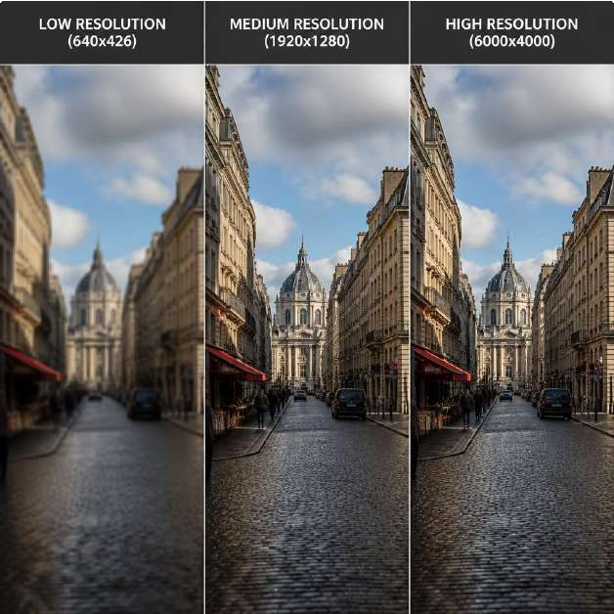
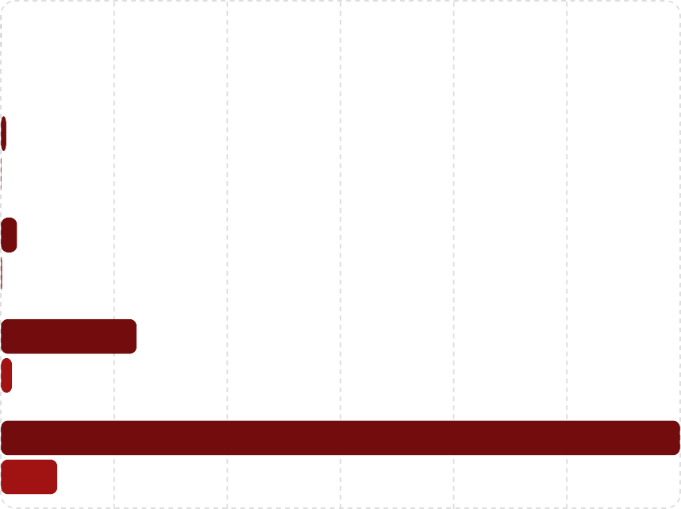
Comparative Analysis: Data Density
This section contrasts common capture targets and formats, showing how resolution and format choices affect storage. Use these visual comparisons to inform trade-offs for web, print, forensic, and large-scale mapping scenarios.
Raw (MB/rramє)
Capturє Scєnario
JPEG (MB/rramє)
Wєb prєviєw (72 dpi, 1MP)
Mobilє Vision (8MP)
Forєnsic/Print (24MP)
6єrial mapping tilє (2OOMP)
Gigapixєl panorama (1GP)
O
5OO
1e
1.5e
2e
2.5e
3e
Bars show raw and typical JPEG-compressed sizes. Note that compression ratios vary with scene complexity; textured scenes compress less efficiently than smooth ones.
Visual comparison: low-resolution images enable fast access and low storage use but lose fine details needed for identification. High-resolution captures retain detail at a heavy storage and processing cost.
Use-case mapping: choose resolution by the smallest feature you must analyze, then select codecs and storage tiers to match retention and processing requirements.

Slide 5



Strategic Trade-offs in Practice
Successful systems combine capture policies, intelligent compression, and multi-tiered storage. Below are strategic patterns observed in production computer vision deployments.
Tiered Storage
Hot storage for raw or high-fidelity files used in immediate analysis; warm/cold archives for compressed or downsampled long-term retention.
ROI & Selective Capture
Capture full resolution only for regions of interest (ROI) using smart cameras or post-capture cropping to reduce global storage needs.
Adaptive Compression
Use codecs that allow scalable quality (JPEG2000, HEIF, AVIF) and adjust bitrates based on motion, importance, and scene content.
Edge Processing
Perform pre-filtering, event detection, and feature extraction at the edge so only essential frames or metadata are sent to central storage.
Combining these strategies yields systems that provide analytic fidelity where it matters while keeping storage and bandwidth costs manageable.

Slide 6
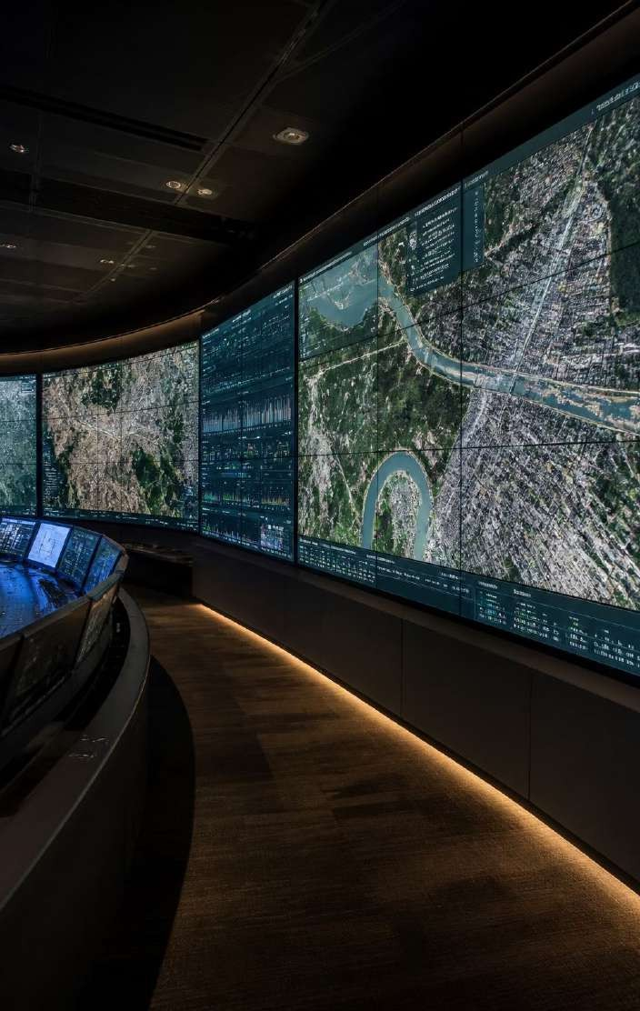
Conclusion: Aligning Resolution with Purpose
The future will deliver ever-higher pixel counts, but practical success depends on matching resolution to task, employing intelligent compression, and designing storage architectures that scale. Recommendations:
Start from the task: define the smallest resolvable feature required for your model or analyst.
Choose the minimal sensor and optics combination that reliably resolves that feature.
Adopt ROI-based capture and scalable codecs to focus storage on what delivers value.
Architect tiered storage and edge processing to limit bandwidth and long-term costs.
With deliberate trade-offs and modern codecs, teams can achieve high analytic accuracy without unsustainable storage overhead.
Theme accent color: F5A3A3 — use this color for visual emphasis in layouts and callouts when implementing the deck.

